Slide 1
CSE 331
Automata and computability
PDAs
Summer 2026

Slide 2
Today's learning goals Sipser Ch 1.4, 2.1
Define push down automata
Trace the computation of a push down automaton
Design a push down automaton recognizing a given language
Compare class of regular languages and class of CFLs

Slide 3
Birds' eye view
All languages over Σ
Context-free languages over Σ
Regular languages over Σ
Finite languages over Σ

Slide 4
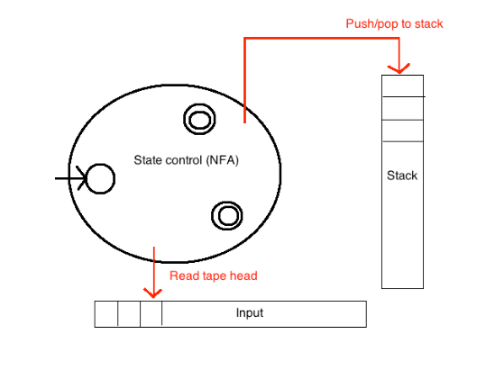
An alternative … Sipser p. 109
NFA + stack

Slide 5
Pushdown automata Sipser p. 109
NFA + stack
At each step
1. Transition to new state based on current state, letter read, and top letter of stack.
2. (Possibly) push or pop a letter to (or from) top of stack

Slide 6
Pushdown automata Sipser p. 109
NFA + stack
Accept a string if
there is some sequence of states and some sequence of stack contents which processes the entire input string and ends in an accepting state.

Slide 7
State diagram for PDA Sipser p. 109
If hand-drawn or in Sipser
State transition labelled a, b → c means
"when machine reads an a from the input and the top symbol of the stack is a b, it may replace the b with a c."

Slide 8
State diagram for PDA Sipser p. 109
If hand-drawn or in Sipser
State transition labelled a, b → c means
"when machine reads an a from the input and the top symbol of the stack is a b, it may replace the b with a c."
What edge label would indicate "Read a 0, pop 0 from stack, don’t push anything to the stack"?
0, 0 → ε
ε, 0 → 0
0, ε → 0
ε → ε, 0
I don't know.

Slide 9
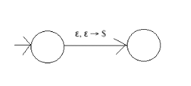
Useful trick
What would ε, ε → $ mean?
Without reading any input or popping any symbol from stack, push $
If the input string and stack are both empty strings, push $
At the end of reading the input string, push $ to top of stack
I don't know.
Why is this useful?
Commonly used from initial state (at start of computation) to record top of stack with a special symbol)
"If the stack becomes empty and …"

Slide 10
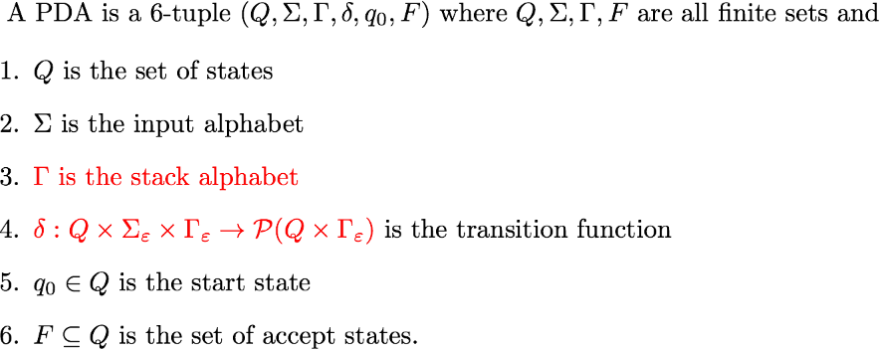
Formal definition of PDA Sipser Def 2.13 p. 111

Slide 11

Design a PDA
Build a PDA that accepts the language
{ a^{n}b^{n} | $n∈ℕ$}

Slide 12
Designing a PDA
L = { 0^{i}1^{i+1} | i ≥ 0 }
Informal description of PDA:
Read symbols from the input. As each 0 is read, push it onto the stack. As soon as 1s are seen, pop a 0 off the stack for each 1 read. If the stack becomes empty and there is exactly one 1 left to read, read that 1 and accept the input. If the stack becomes empty and there are either zero or more than one 1s left to read, or if the 1s are finished while the stack still contains 0s, or if any 0s appear in the input following 1s, reject the input.

Slide 13
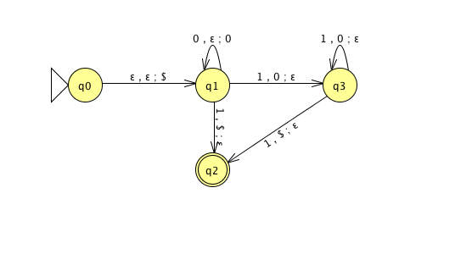
Designing/Tracing a PDA
L = { 0^{i}1^{i+1} | i ≥ 0 }
Sample computations?
nondeterminism
stack contents

Slide 14
Designing a PDA
L = { 0^{i}1^{i+1} | i ≥ 0 }
Which of these CFGs generate L?
Assume V = set of variables mentioned in rules; Σ={0,1}, S start
S → ε | 0S1
S → ε | 0S11
S → T1 | 0S1, T → ε
S → ε | 0T1, T → ε | 0T1
None of those

Slide 15
Design a PDA
Build a PDA that accepts the language
{ w | w is a palindrome}

Slide 16

Design a PDA
Build a PDA that accepts the language
{ a^{3n}b^{2n} | $n∈ℕ$}

Slide 17

Design a PDA
Build a PDA that accepts the language
$$\text{\{}\text{anbm}\text{ | }n>m and m,n∈ℕ\text{\}}$$

Slide 18
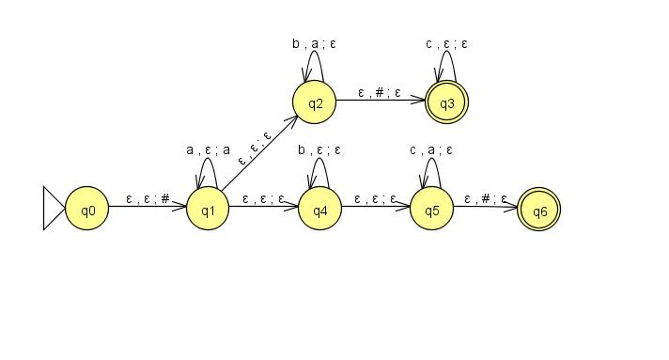
Designing a PDA
L = { a^{i}b^{j}c^{k} | i=j or i=k, with i,j,k≥0 }
Formal definition of PDA:

Slide 19
Challenge construction
Given word w, and character c, define
count(w,c) = count of c in w
Consider the language
L={w₁ w₂: w₁,w₂ in {0,1}*,count(w₁,0)=count(w₂,1)}
Design a CFG and PDA for it

Slide 20
Challenge PDA construction
L={w₁ w₂: w₁,w₂ in {0,1}*,count(w₁,0)=count(w₂,1)}

Slide 21
Challenge CFG construction
L={w₁ w₂: w₁,w₂ in {0,1}*,count(w₁,0)=count(w₂,1)}

Slide 22

Challenge: design a PDA
Build a PDA that accepts the language
$$\{x∈{\left\{a,b\right\}}^{∗}:\text{\#}\text{a} \text{in} \text{x}\text{ = \#}\text{b} \text{in} \text{x}\text{\}}$$

Slide 23
Design a PDA
Build a PDA that accepts the language
{w | the number of a’s in w is not same as the number of b’s in w}

Slide 24
Design a PDA
Build a PDA that accepts the language
{x#y | the number of 00 substring in x is equal to the number of 11 substring in y}

Slide 25
Design a PDA
Build a PDA that accepts the language
{w| w starts and end with the same character}

Slide 26
PDAs and CFGs are equivalently expressive
Theorem 2.20: A language is context-free if and only some nondeterministic PDA recognizes it.
Consequences
Quick proof that every regular language is context free
To prove closure of class of CFLs under a given operation, can choose two modes of proof (via CFGs or PDAs) depending on which is easier

Slide 27
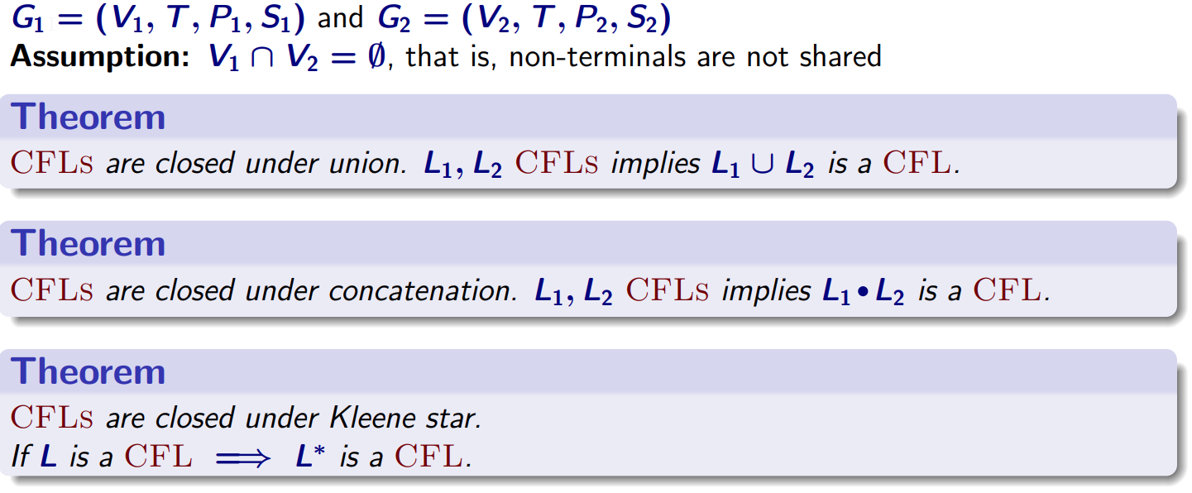
Closure properties of CFLs

Slide 28
More bad news: CFL not closed under intersection
complement.

Slide 29
Example
L = { a^{i}b^{j}c^{k} | i=j or i=k, with i,j,k≥0 }
To design a CFG that generates L…
L = { a^{i}b^{j}c^{k} | i=j, with i,j,k≥0 } U { a^{i}b^{j}c^{k} | i=k, with i,j,k≥0 }
S → Sc | T
T → aTb | ε

Slide 30
Example
L = { a^{i}b^{j}c^{k} | i=j or i=k, with i,j,k≥0 }
To design a CFG that generates L…
L = { a^{i}b^{j}c^{k} | i=j, with i,j,k≥0 } U { a^{i}b^{j}c^{k} | i=k, with i,j,k≥0 }
S → T | aSc
T → Tb | ε

Slide 31
Designing a CFG – challenge!
Building a CFG to describe the language
{ ww | w in Σ*}
V = { S }
Σ = { a,b }
R = ?
S
This language is not context free!
This can be proved using a
“pumping lemma” for context free languages

